Slide 1
Divide and Conquer Algorithms - 1
Md. Muktar Hossain
Lecturer
Dept. of CSE
Varendra university

Slide 2
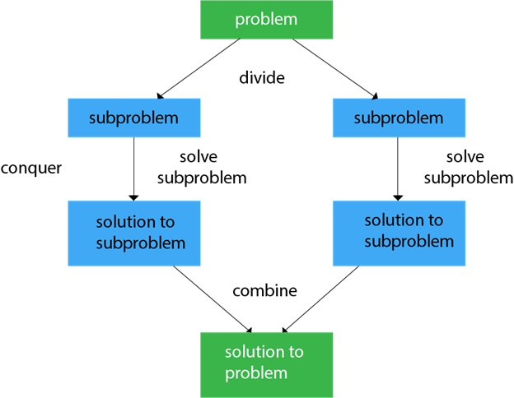
Divide and Conquer
Divide and Conquer Algorithm is a problem-solving technique used to solve problems by dividing the main problem into subproblems, solving them individually and then merging them to find solution to the original problem.

Slide 3
Divide and Conquer Cont’d
General Steps of Divide and Conquer:
Divide: Split the problem into two or more smaller subproblems.
Conquer: Solve each of the subproblems. If the subproblem is small enough, solve it directly (often recursively).
Combine: Combine the solutions to the subproblems to solve the original problem.
Key Characteristics:
Recursion: Divide and conquer typically uses recursion to solve subproblems.
Divide and Combine Operations: The problem is split into subproblems, and the subproblem results are merged to solve the original problem.
Efficiency: Many divide and conquer algorithms, especially when used in sorting or searching, can achieve optimal time complexity.

Slide 4
Divide and Conquer Cont’d
General Steps of Divide and Conquer
Divide: Split the problem into two or more smaller subproblems.
Conquer: Solve each of the subproblems. If the subproblem is small enough, solve it directly (often recursively).
Combine: Combine the solutions to the subproblems to solve the original problem.
Key Characteristics
Recursion: Divide and conquer typically uses recursion to solve subproblems.
Divide and Combine Operations: The problem is split into subproblems, and the subproblem results are merged to solve the original problem.
Efficiency: Many divide and conquer algorithms, especially when used in sorting or searching, can achieve optimal time complexity.

Slide 5
Divide and Conquer Cont’d
Pros
Efficiency: Many divide and conquer algorithms (like binary search, merge sort and quick sort) are very efficient compared to simpler approaches.
Parallelism: The independent subproblems in divide and conquer are often suitable for parallel execution, leading to faster algorithms on multi-core machines.
Cons
Overhead: Recursive calls can lead to overhead, especially if the recursion depth is high.
Space Complexity: Some divide and conquer algorithms (e.g., merge sort) require additional memory space, leading to higher space complexity.

Slide 6
Merge Sort
Merge Sort is a classic divide-and-conquer sorting algorithm that works by dividing the input array into smaller subarrays, sorting those subarrays, and then merging them back together to form a sorted array.
Algorithm:
Divide:
If the array has more than one element, find the middle index, and divide the array into two subarrays.
If the array contains only one element, it is already sorted by definition.
Conquer:
Recursively apply merge sort to the two halves of the array.
Combine (Merge Step):
After the two halves are sorted, merge them by comparing the elements of both halves and arranging them in sorted order.
This involves comparing the smallest unmerged element from each half, picking the smaller element, and placing it into the result array.
Repeat the process until all elements from both halves are merged.

Slide 7
Merge Sort Cont’d
void mergeSort(int arr[], int l, int r)
{
if (l < r) {
int m = l + (r - l) / 2;
mergeSort(arr, l, m);
mergeSort(arr, m + 1, r);
merge(arr, l, m, r);
}
}
45 | 23 | 28 | 72 | 18

Slide 8
Merge Sort Cont’d
void mergeSort(int arr[], int l, int r)
{
if (l < r) {
int m = l + (r - l) / 2;
mergeSort(arr, l, m);
mergeSort(arr, m + 1, r);
merge(arr, l, m, r);
}
}
45 | 23 | 28 | 72 | 18
45(l) | 23(m) | 28 | 72 | 18(r)

Slide 9
Merge Sort Cont’d
void mergeSort(int arr[], int l, int r)
{
if (l < r) {
int m = l + (r - l) / 2;
mergeSort(arr, l, m);
mergeSort(arr, m + 1, r);
merge(arr, l, m, r);
}
}
45 | 23 | 28 | 72 | 18
45(l) | 23(m) | 28 | 72 | 18(r)
45(l)(m) | 23(r)

Slide 10
Merge Sort Cont’d
void mergeSort(int arr[], int l, int r)
{
if (l < r) {
int m = l + (r - l) / 2;
mergeSort(arr, l, m);
mergeSort(arr, m + 1, r);
merge(arr, l, m, r);
}
}
45 | 23 | 28 | 72 | 18
45(l) | 23(m) | 28 | 72 | 18(r)
45(l)(m) | 23(r)
45(l)(r)

Slide 11
Merge Sort Cont’d
void mergeSort(int arr[], int l, int r)
{
if (l < r) {
int m = l + (r - l) / 2;
mergeSort(arr, l, m);
mergeSort(arr, m + 1, r);
merge(arr, l, m, r);
}
}
45 | 23 | 28 | 72 | 18
45(l) | 23(m) | 28 | 72 | 18(r)
45(l)(m) | 23(r)
45
23(l)(r)

Slide 12
Merge Sort Cont’d
void mergeSort(int arr[], int l, int r)
{
if (l < r) {
int m = l + (r - l) / 2;
mergeSort(arr, l, m);
mergeSort(arr, m + 1, r);
merge(arr, l, m, r);
}
}
45 | 23 | 28 | 72 | 18
45(l) | 23(m) | 28 | 72 | 18(r)
45(l)(m) | 23(r)
28(l) | 72(m) | 18(r)
45
23

Slide 13
Merge Sort Cont’d
void mergeSort(int arr[], int l, int r)
{
if (l < r) {
int m = l + (r - l) / 2;
mergeSort(arr, l, m);
mergeSort(arr, m + 1, r);
merge(arr, l, m, r);
}
}
45 | 23 | 28 | 72 | 18
45(l) | 23(m) | 28 | 72 | 18(r)
45(l)(m) | 23(r)
28(l) | 72(m) | 18(r)
45
23
28(l)(m) | 72(r)

Slide 14
Merge Sort Cont’d
void mergeSort(int arr[], int l, int r)
{
if (l < r) {
int m = l + (r - l) / 2;
mergeSort(arr, l, m);
mergeSort(arr, m + 1, r);
merge(arr, l, m, r);
}
}
45 | 23 | 28 | 72 | 18
45(l) | 23(m) | 28 | 72 | 18(r)
45(l)(m) | 23(r)
28(l) | 72(m) | 18(r)
45
23
28(l)(m) | 72(r)
28(l)(r)

Slide 15
Merge Sort Cont’d
void mergeSort(int arr[], int l, int r)
{
if (l < r) {
int m = l + (r - l) / 2;
mergeSort(arr, l, m);
mergeSort(arr, m + 1, r);
merge(arr, l, m, r);
}
}
45 | 23 | 28 | 72 | 18
45(l) | 23(m) | 28 | 72 | 18(r)
45(l)(m) | 23(r)
28(l) | 72(m) | 18(r)
45
23
28(l)(m) | 72(r)
28
28(l)(r)

Slide 16
Merge Sort Cont’d
void mergeSort(int arr[], int l, int r)
{
if (l < r) {
int m = l + (r - l) / 2;
mergeSort(arr, l, m);
mergeSort(arr, m + 1, r);
merge(arr, l, m, r);
}
}
45 | 23 | 28 | 72 | 18
45(l) | 23(m) | 28 | 72 | 18(r)
45(l)(m) | 23(r)
28(l) | 72(m) | 18(r)
45
23
28(l)(m) | 72(r)
18(l)(r)
28
72

Slide 17
Merge Sort Cont’d
void mergeSort(int arr[], int l, int r)
{
if (l < r) {
int m = l + (r - l) / 2;
mergeSort(arr, l, m);
mergeSort(arr, m + 1, r);
merge(arr, l, m, r);
}
}
45 | 23 | 28 | 72 | 18
45(l) | 23(m) | 28 | 72 | 18(r)
45(l)(m) | 23(r)
28(l) | 72(m) | 18(r)
45
23
28(l)(m) | 72(r)
18
28
72

Slide 18
Merge Sort Cont’d
void merge(int arr[], int l, int m, int r) { int i, j, k; int n1 = m - l + 1; int n2 = r - m; int L[n1], R[n2]; for (i = 0; i < n1; i++) L[i] = arr[l + i]; for (j = 0; j < n2; j++) R[j] = arr[m + 1 + j]; i = 0; j = 0; k = l; | while (i < n1 && j < n2) { if (L[i] <= R[j]) { arr[k] = L[i]; i++; } else { arr[k] = R[j]; j++; } k++; } while (i < n1) { arr[k] = L[i]; i++; k++; } while (j < n2) { arr[k] = R[j]; j++; k++; } }
45 | 23 | 28 | 72 | 18
45(l) | 23(m) | 28 | 72 | 18(r)
45(l)(m) | 23(r)
28(l) | 72(m) | 18(r)
45
23
28(l)(m) | 72(r)
18
28
72
28 | 72

Slide 19
Merge Sort Cont’d
void merge(int arr[], int l, int m, int r) { int i, j, k; int n1 = m - l + 1; int n2 = r - m; int L[n1], R[n2]; for (i = 0; i < n1; i++) L[i] = arr[l + i]; for (j = 0; j < n2; j++) R[j] = arr[m + 1 + j]; i = 0; j = 0; k = l; | while (i < n1 && j < n2) { if (L[i] <= R[j]) { arr[k] = L[i]; i++; } else { arr[k] = R[j]; j++; } k++; } while (i < n1) { arr[k] = L[i]; i++; k++; } while (j < n2) { arr[k] = R[j]; j++; k++; } }
45 | 23 | 28 | 72 | 18
45(l) | 23(m) | 28 | 72 | 18(r)
45(l)(m) | 23(r)
28(l) | 72(m) | 18(r)
45
23
28 | 72
18
28
72
28 | 72
18 | 28 | 72

Slide 20
Merge Sort Cont’d
void merge(int arr[], int l, int m, int r) { int i, j, k; int n1 = m - l + 1; int n2 = r - m; int L[n1], R[n2]; for (i = 0; i < n1; i++) L[i] = arr[l + i]; for (j = 0; j < n2; j++) R[j] = arr[m + 1 + j]; i = 0; j = 0; k = l; | while (i < n1 && j < n2) { if (L[i] <= R[j]) { arr[k] = L[i]; i++; } else { arr[k] = R[j]; j++; } k++; } while (i < n1) { arr[k] = L[i]; i++; k++; } while (j < n2) { arr[k] = R[j]; j++; k++; } }
45 | 23 | 28 | 72 | 18
45(l) | 23(m) | 28 | 72 | 18(r)
45(l)(m) | 23(r)
28 | 72 | 18
45
23
28 | 72
18
23 | 45
28
72
28 | 72
18 | 28 | 72

Slide 21
Merge Sort Cont’d
void merge(int arr[], int l, int m, int r) { int i, j, k; int n1 = m - l + 1; int n2 = r - m; int L[n1], R[n2]; for (i = 0; i < n1; i++) L[i] = arr[l + i]; for (j = 0; j < n2; j++) R[j] = arr[m + 1 + j]; i = 0; j = 0; k = l; | while (i < n1 && j < n2) { if (L[i] <= R[j]) { arr[k] = L[i]; i++; } else { arr[k] = R[j]; j++; } k++; } while (i < n1) { arr[k] = L[i]; i++; k++; } while (j < n2) { arr[k] = R[j]; j++; k++; } }
45 | 23 | 28 | 72 | 18
45(l) | 23(m) | 28 | 72 | 18(r)
45 | 23
28 | 72 | 18
45
23
28 | 72
18
23 | 45
28
72
28 | 72
18 | 28 | 72
18 | 23 | 28 | 45 | 72

Slide 22
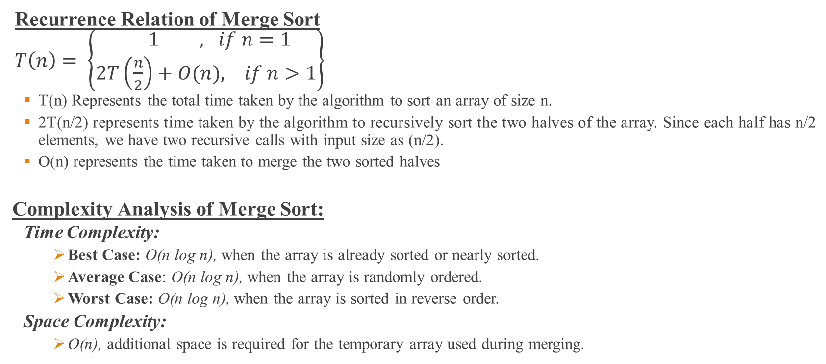
Merge Sort Cont’d
Recurrence Relation of Merge Sort
$T\left(n\right)= \left\{\begin{aligned} 1 , if n=1 \\ 2T\left(\frac{n}{2}\right)+O(n), if n>1\end{aligned}\right\}$
T(n) Represents the total time taken by the algorithm to sort an array of size n.
2T(n/2) represents time taken by the algorithm to recursively sort the two halves of the array. Since each half has n/2 elements, we have two recursive calls with input size as (n/2).
O(n) represents the time taken to merge the two sorted halves
Complexity Analysis of Merge Sort:
Time Complexity:
Best Case: O(n log n), when the array is already sorted or nearly sorted.
Average Case: O(n log n), when the array is randomly ordered.
Worst Case: O(n log n), when the array is sorted in reverse order.
Space Complexity:
O(n), additional space is required for the temporary array used during merging.

Slide 23
Thank You

